Slide 1

Expense Tracker App

Slide 2
Submitted To:
Mr. Mandeep Singh
(Technical Head)
Submitted By:
Himanshu Bansal (191500341)
Ronak Agrawal (191500678)
Lakshya Yadav (191500427)

Slide 3

Home Page

Slide 4
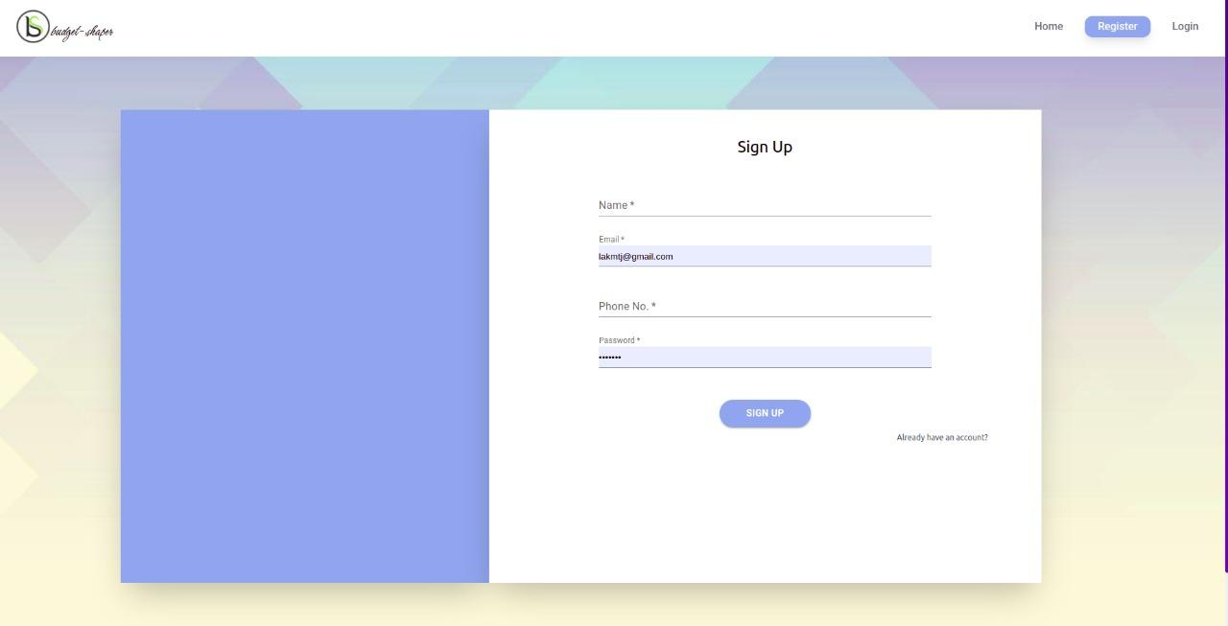
Register Page

Slide 5
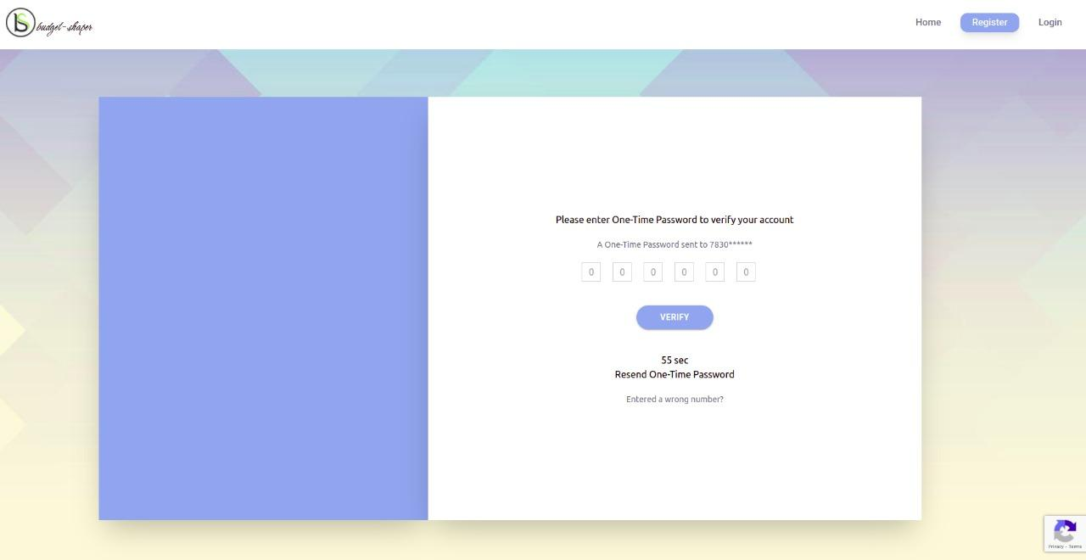
Verify Mobile Number After Registration

Slide 6
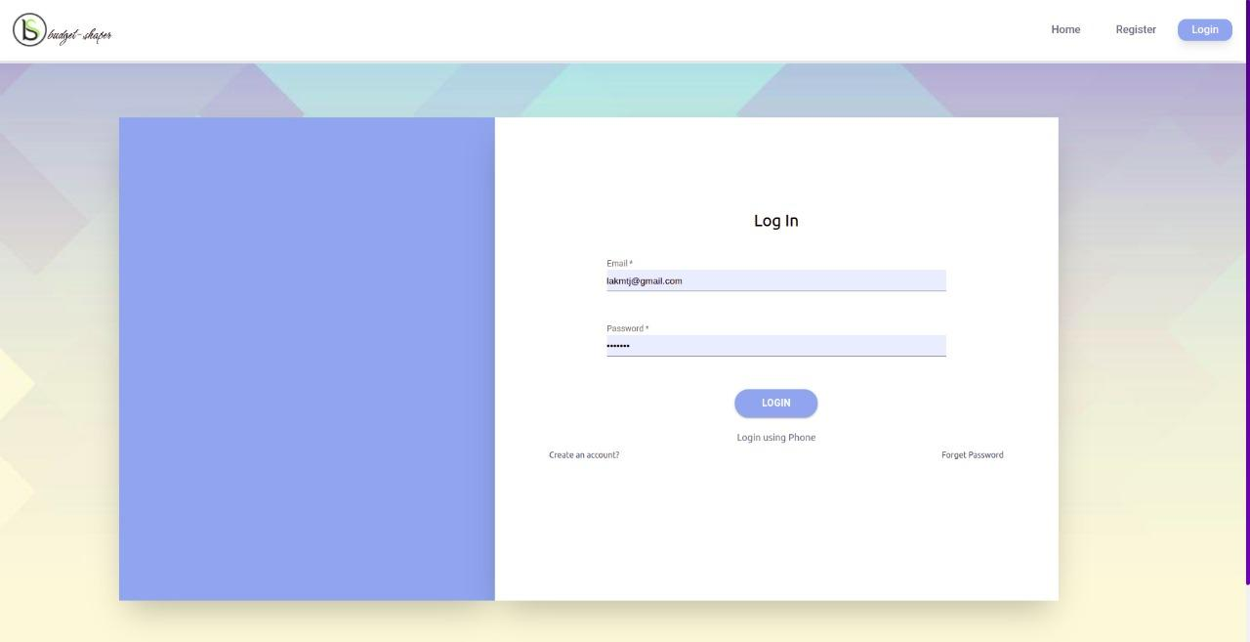
Login Page

Slide 7

Login Using Phone Number and OTP

Slide 8
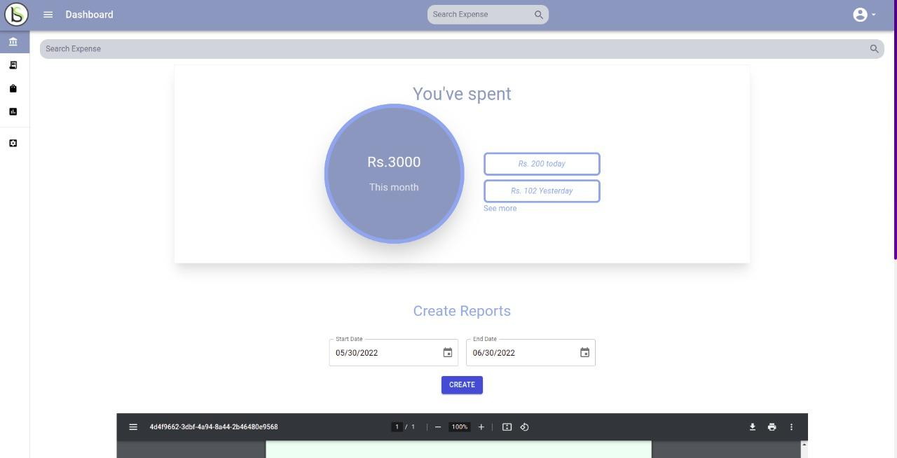
Dashboard Page After Login
Search expense from anywhere and go to expenses page

Slide 9
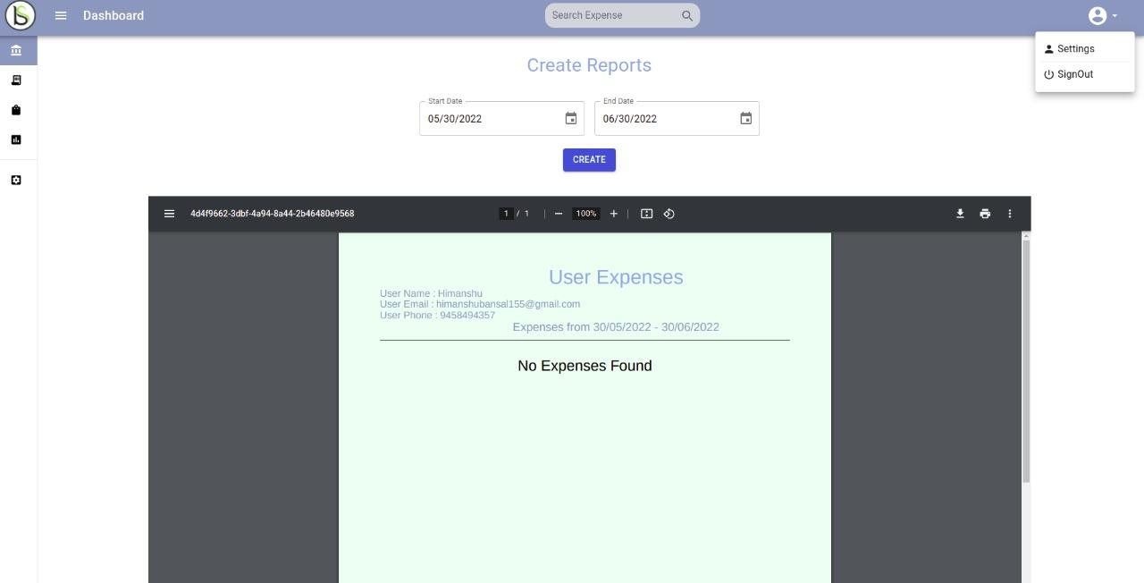
Create Reports for Expenses by filtering with dates
Sign out to logout user

Slide 10
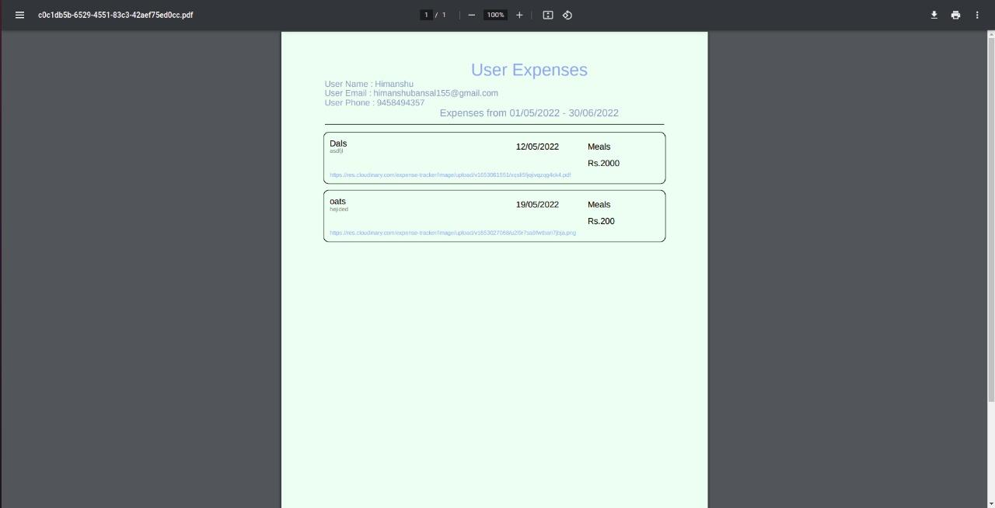
Downloaded pdf created from Dashboard

Slide 11
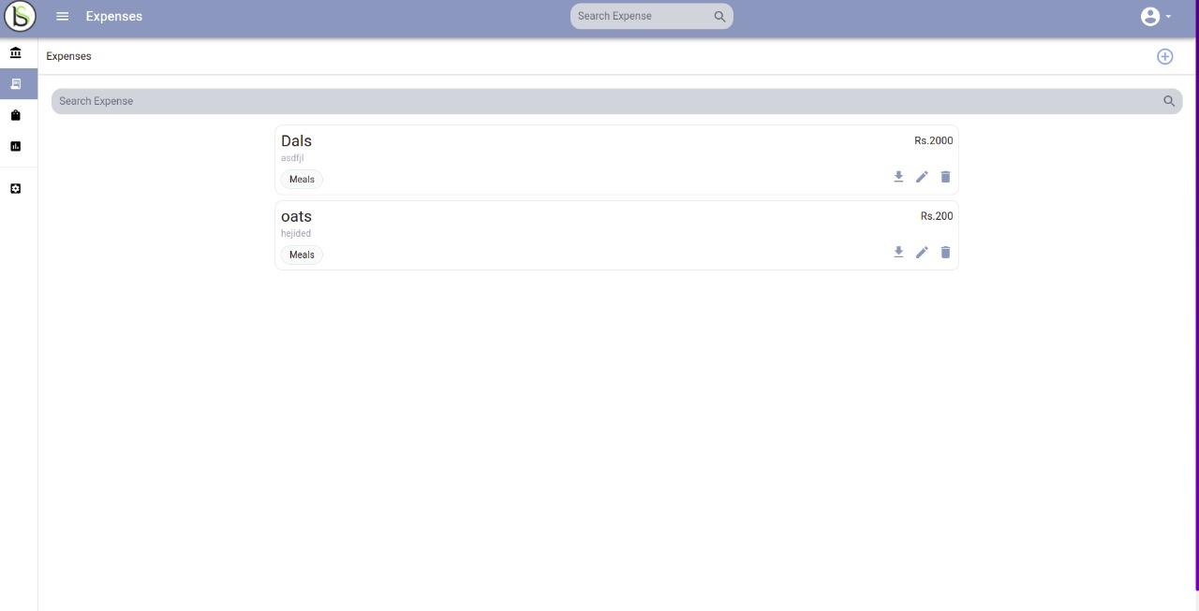
Expenses Page to Show All expenses

Slide 12

Expense Card
Title
Amount
Description
Category
Download Reciept
Delete Expense
Edit Expense

Slide 13
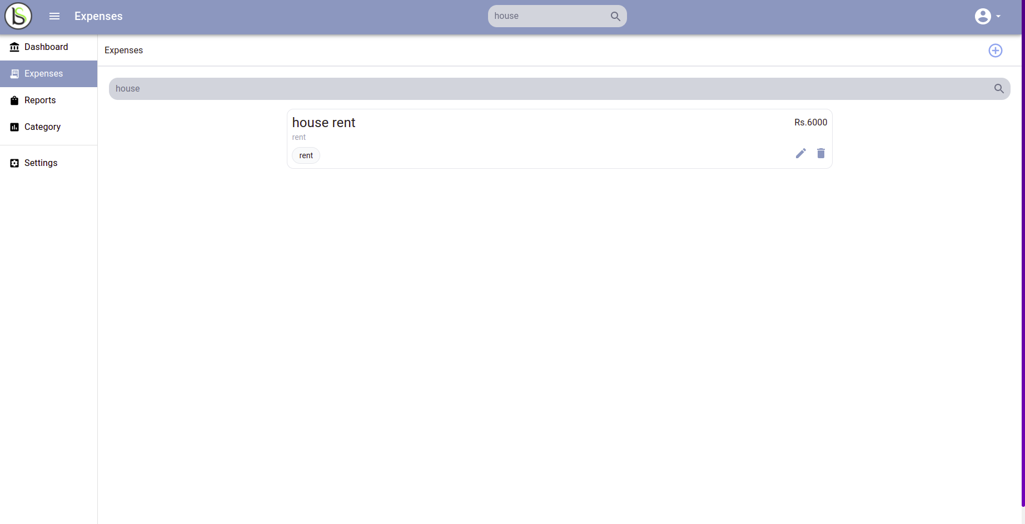
SideBar to open every page And Search Bar used to search expenses
Button to open and close sidebar
Text added to search expense by name

Slide 14
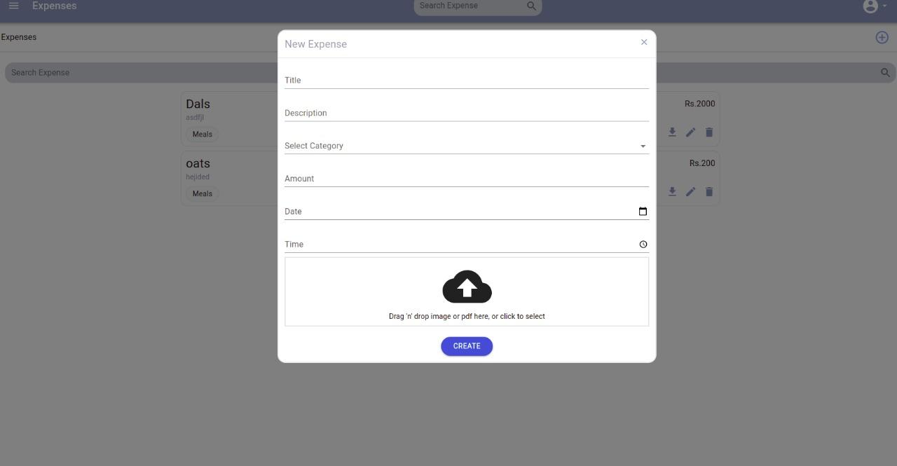
Create Expenses Modal and its button at expenses page

Slide 15


Loader used in app to show app Loading

Slide 16
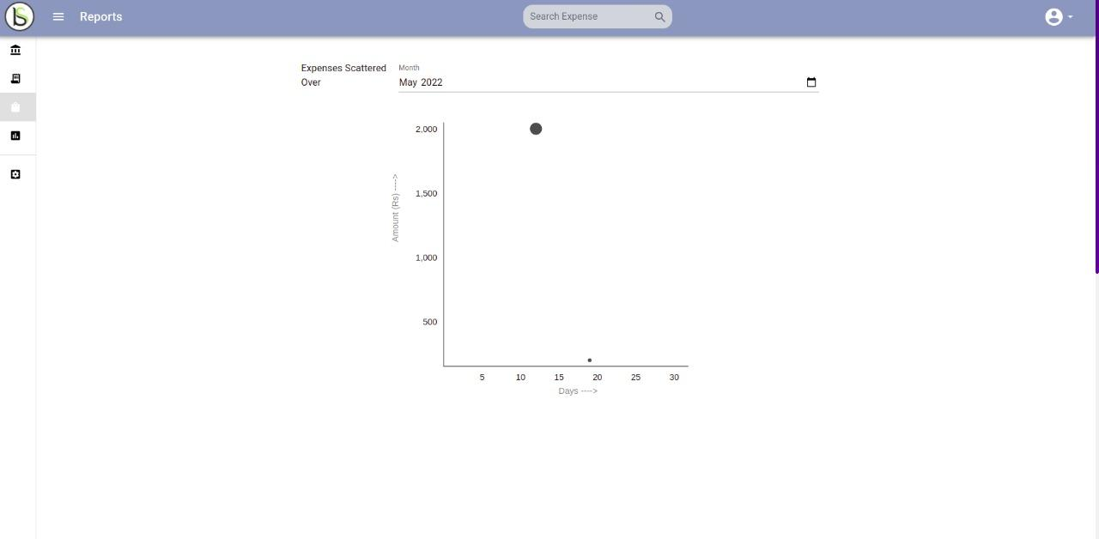
Expenses Plotted Using Per Month Filter
Picker to select month
Hover on dots to see expense details

Slide 17
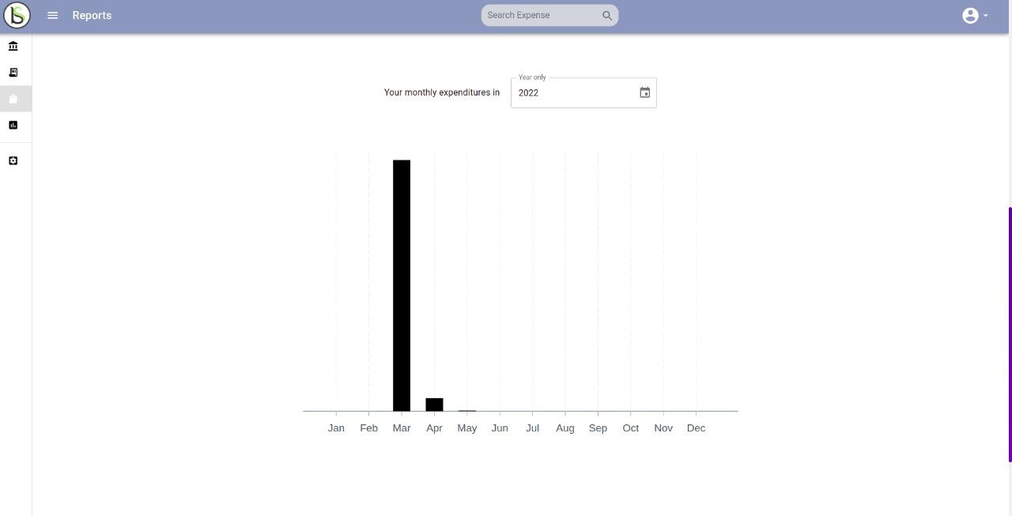
Get Your Total Month Expense Using Year filter
Picker to select year

Slide 18
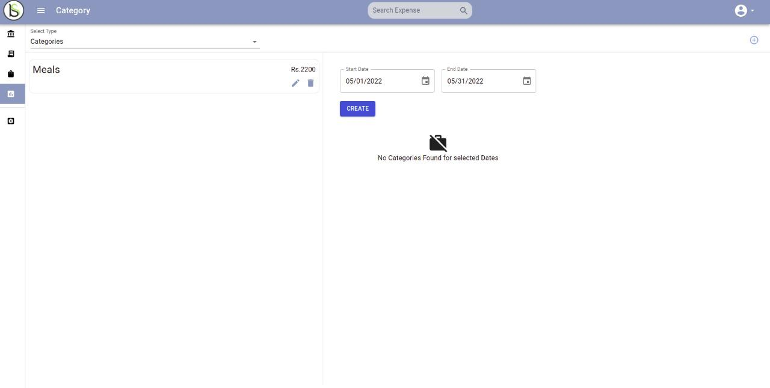
Categories Page to Show All Categories

Slide 19

Category Card
Title
Total Amount Spended by Category
Delete Category
Edit Category

Slide 20
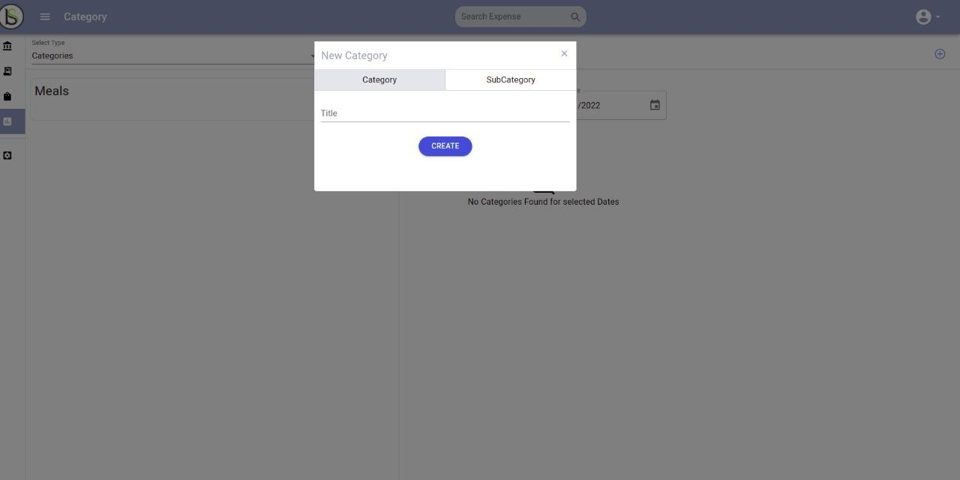
Modal to Create categories and subCategories
Button to create Category

Slide 21
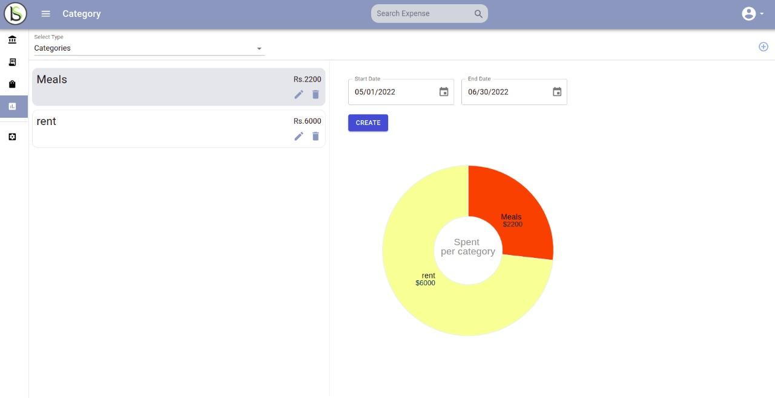
Pie Chart to show Total Amount Per Category
Filters to show categories between specific dates

Slide 22
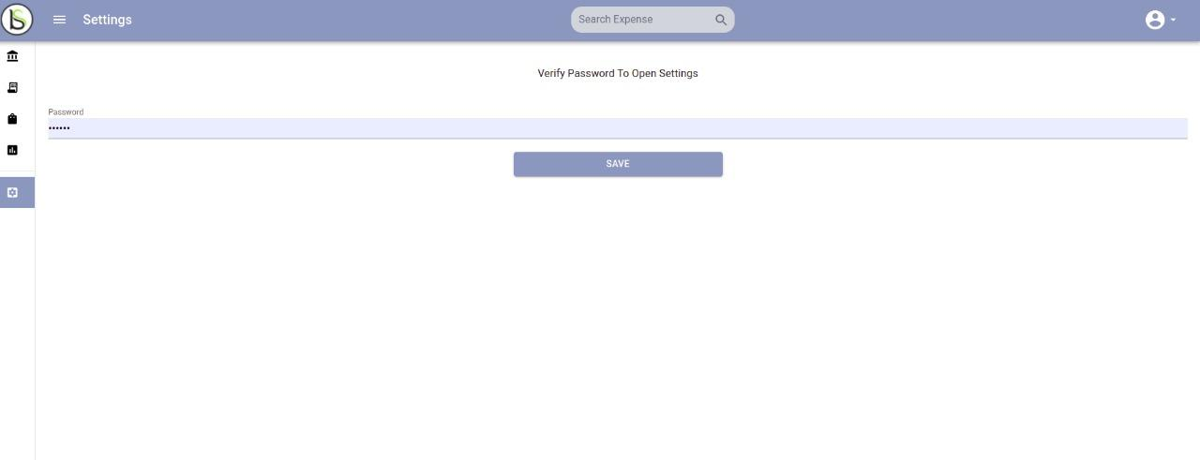
Settings page to Change User Profile
First Verify Your Password to change user fields
Click on save to move to next page

Slide 23
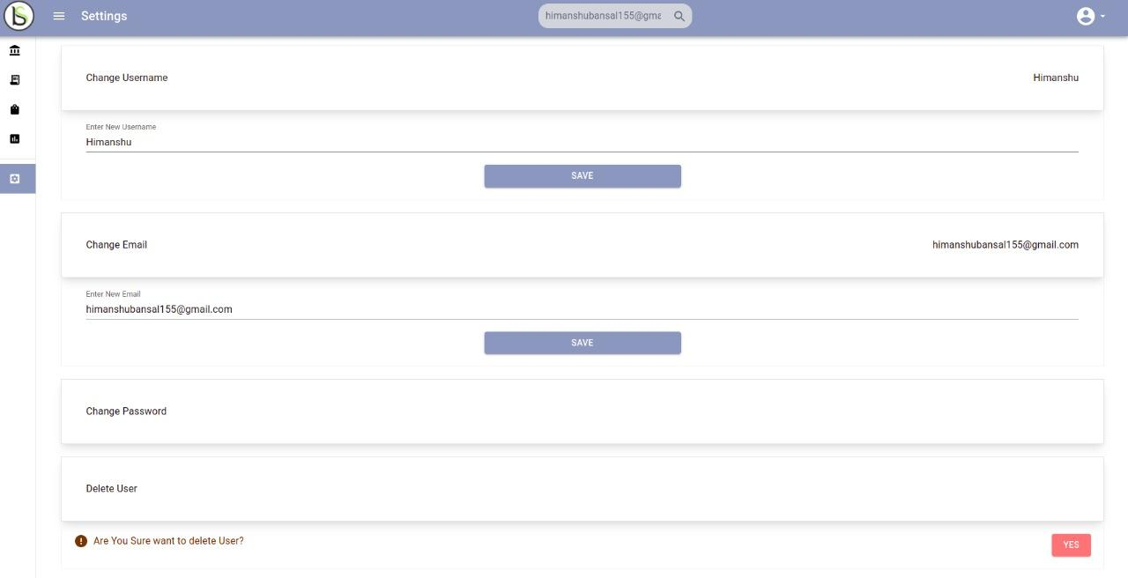
User Fields to change user details
Each Field has its own button to save specific details

Slide 24
Thank You

